Slide 1

How to Build a Table with Pandas
Data Handling and Visualisation Week 3 – Dr Mike Kuhn

Slide 2
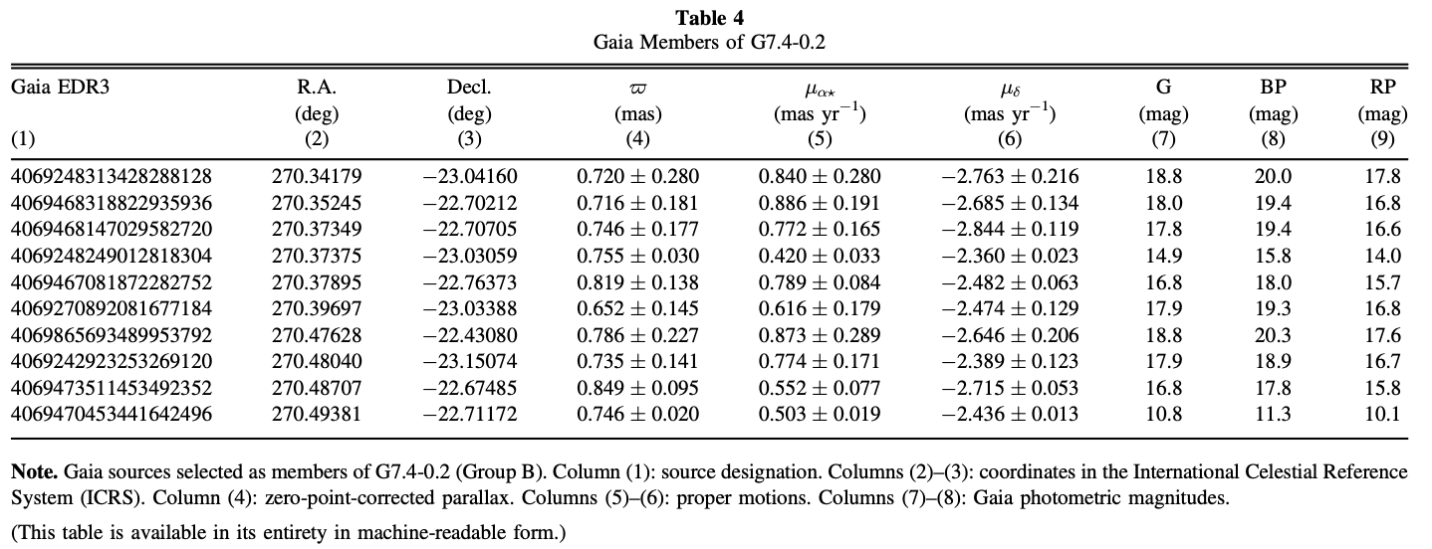
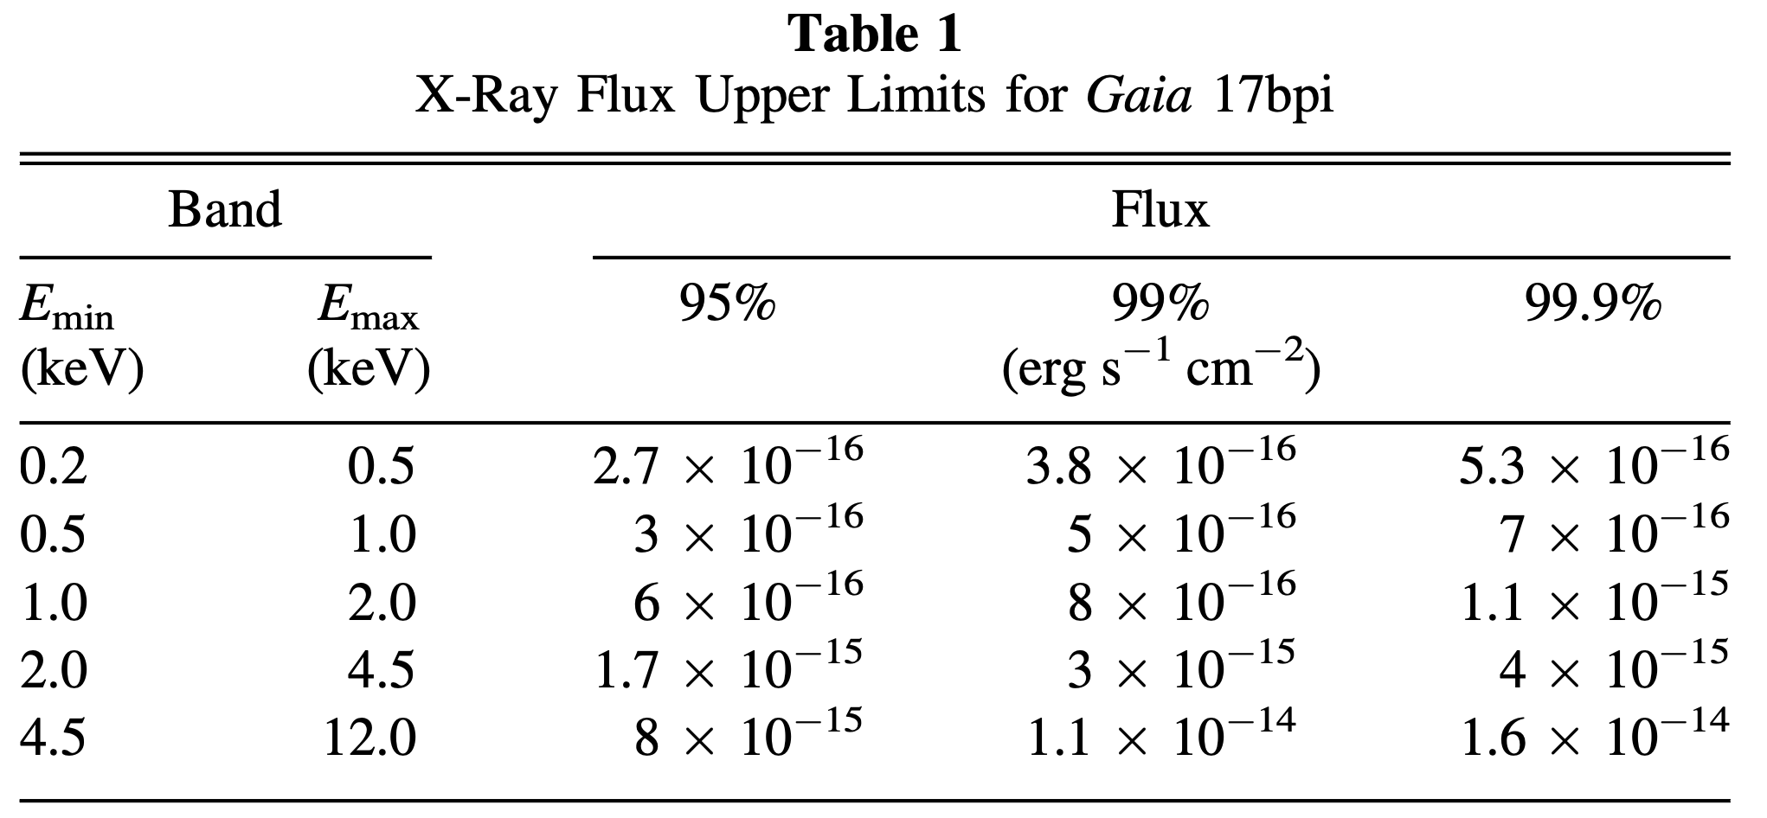
Tables are fundamental in data science
Others are vehicals for storing large datasets
Kuhn+2020
Some tables are meant for human readers
Kuhn+2019

Slide 3

Example table
Causes of deaths
GBD 2015 Mortality and Causes of Death Collaborators 2016, The Lancet, 388, 1459
https://www.thelancet.com/action/showPdf?pii=S0140-6736%2816%2931012-1
The full table is 10 pages long.

Slide 4
Data Frames
Data frames store tabular data of multiple different types.
In Python's pandas library these are "Data Frame" objects
pandas.core.frame.DataFrame
Data frames consist of column names, indices, and the data
length width height
0 12.5 7.3 3.2
1 8.9 6.1 2.5
2 10.2 5.5 3.0
3 11.1 7.8 3.5
4 9.3 6.9 2.8

Slide 5
Data Frames
In [27]: df
Out[27]:
length width height
0 12.5 7.3 3.2
1 8.9 6.1 2.5
2 10.2 5.5 3.0
3 11.1 7.8 3.5
4 9.3 6.9 2.8
In [28]: df.columns
Out[28]: Index(['length', 'width', 'height'], dtype='object')
In [29]: df.length
Out[29]:
0 12.5
1 8.9
2 10.2
3 11.1
4 9.3
Name: length, dtype: float64
In [30]: df['width']
Out[30]:
0 7.3
1 6.1
2 5.5
3 7.8
4 6.9
Name: width, dtype: float64
column names
data from the length column
data from the width column

Slide 6
Is there a difference?
In [86]: df.length
In [87]: df['length']

Slide 7
Is there a difference?
In [86]: df.length
Out[86]:
0 12.5
1 8.9
2 10.2
3 11.1
4 9.3
Name: length, dtype: float64
In [87]: df['length']
Out[87]:
0 12.5
1 8.9
2 10.2
3 11.1
4 9.3
Name: length, dtype: float64
No.

Slide 8
Picking an element out of a data frame
In [54]: df
Out[54]:
length width height
0 12.5 7.3 3.2
1 8.9 6.1 2.5
2 10.2 5.5 3.0
3 11.1 7.8 3.5
4 9.3 6.9 2.8
In [55]: df.length[1]

Slide 9
Picking an element out of a data frame
In [54]: df
Out[54]:
length width height
0 12.5 7.3 3.2
1 8.9 6.1 2.5
2 10.2 5.5 3.0
3 11.1 7.8 3.5
4 9.3 6.9 2.8
In [55]: df.length[1]
Out[55]: 8.9

Slide 10
Picking an element out of a data frame
In [54]: df
Out[54]:
length width height
0 12.5 7.3 3.2
1 8.9 6.1 2.5
2 10.2 5.5 3.0
3 11.1 7.8 3.5
4 9.3 6.9 2.8
In [55]: df["width"][2]

Slide 11
Picking an element out of a data frame
In [54]: df
Out[54]:
length width height
0 12.5 7.3 3.2
1 8.9 6.1 2.5
2 10.2 5.5 3.0
3 11.1 7.8 3.5
4 9.3 6.9 2.8
In [55]: df["width"][2]
Out[55]: 5.5

Slide 12
Picking an element out of a data frame
In [54]: df
Out[54]:
length width height
0 12.5 7.3 3.2
1 8.9 6.1 2.5
2 10.2 5.5 3.0
3 11.1 7.8 3.5
4 9.3 6.9 2.8
In [55]: df["width"][2] = df["width"][2] + 1
In [56]: df["width"][2]

Slide 13
Picking an element out of a data frame
In [54]: df
Out[54]:
length width height
0 12.5 7.3 3.2
1 8.9 6.1 2.5
2 10.2 5.5 3.0
3 11.1 7.8 3.5
4 9.3 6.9 2.8
In [55]: df["width"][2] = df["width"][2] + 1
In [56]: df["width"][2]
Out[56]: 6.5

Slide 14
Picking an column out of a data frame
In [54]: df
Out[54]:
length width height
0 12.5 7.3 3.2
1 8.9 6.1 2.5
2 10.2 5.5 3.0
3 11.1 7.8 3.5
4 9.3 6.9 2.8
In [72]: type(df["width"])

Slide 15
Picking an column out of a data frame
In [54]: df
Out[54]:
length width height
0 12.5 7.3 3.2
1 8.9 6.1 2.5
2 10.2 5.5 3.0
3 11.1 7.8 3.5
4 9.3 6.9 2.8
In [72]: type(df["width"])
Out[72]: pandas.core.series.Series

Slide 16
Pandas 'Series' object
values
(can be any type)
In [1]: import pandas as pd
In [2]: data = pd.Series([0.25, 0.5, 0.75, 1.0],
...: index=['a', 'b', 'c', 'd'])
In [3]: print(data)
a 0.25
b 0.50
c 0.75
d 1.00
indices

Slide 17
Slicing a Data Frame
In [36]: df
Out[36]:
length width height
0 12.5 7.3 3.2
1 8.9 6.1 2.5
2 10.2 5.5 3.0
3 11.1 7.8 3.5
4 9.3 6.9 2.8
In [37]: df[2:5]
Out[37]:
length width height
2 10.2 5.5 3.0
3 11.1 7.8 3.5
4 9.3 6.9 2.8
In [38]: df[3:]
Out[38]:
length width height
3 11.1 7.8 3.5
4 9.3 6.9 2.8
pick out rows 2 through 4
pick out rows 3 through the last

Slide 18
Slicing a Data Frame
df.loc and df.iloc
In [83]: df
Out[83]:
length width height
0 12.5 7.3 3.2
1 8.9 6.1 2.5
2 10.2 5.5 3.0
3 11.1 7.8 3.5
4 9.3 6.9 2.8
In [84]: df.loc[0,'width']
Out[84]: 7.3

Slide 19
Slicing a Data Frame
df.loc and df.iloc
In [83]: df
Out[83]:
length width height
0 12.5 7.3 3.2
1 8.9 6.1 2.5
2 10.2 5.5 3.0
3 11.1 7.8 3.5
4 9.3 6.9 2.8
In [84]: df.iloc[ ??? , ??? ]
Out[84]: 7.3
what goes here?

Slide 20
Slicing a Data Frame
df.loc and df.iloc
In [83]: df
Out[83]:
length width height
0 12.5 7.3 3.2
1 8.9 6.1 2.5
2 10.2 5.5 3.0
3 11.1 7.8 3.5
4 9.3 6.9 2.8
In [84]: df.iloc[ 0 , 1 ]
Out[84]: 7.3
what goes here?

Slide 21
Slicing a Data Frame
In [95]: df
Out[95]:
length width height
0 12.5 7.3 3.2
1 8.9 6.1 2.5
2 10.2 5.5 3.0
3 11.1 7.8 3.5
4 9.3 6.9 2.8
In [96]: df.loc[3:4,['width','height']]
Out[96]:
width height
3 7.8 3.5
4 6.9 2.8

Slide 22
How would you do the same with df.iloc()?
In [96]: df.loc[3:4,['width','height']]
Out[96]:
width height
3 7.8 3.5
4 6.9 2.8
In [99]: df.iloc[???,???]
Out[99]:
width height
3 7.8 3.5
4 6.9 2.8
what goes here?

Slide 23
How would you do the same with df.iloc()?
In [96]: df.loc[3:4,['width','height']]
Out[96]:
width height
3 7.8 3.5
4 6.9 2.8
In [99]: df.iloc[3:5,1:3]
Out[99]:
width height
3 7.8 3.5
4 6.9 2.8
what goes here?

Slide 24
Boolean selection
In [137]: df
Out[137]:
length width height
0 12.5 7.3 3.2
1 8.9 6.1 2.5
2 10.2 5.5 3.0
3 11.1 7.8 3.5
4 9.3 6.9 2.8
In [138]: df.width > 6
Out[138]:
0 True
1 True
2 False
3 True
4 True
Name: width, dtype: bool

Slide 25
Boolean selection
In [137]: df
Out[137]:
length width height
0 12.5 7.3 3.2
1 8.9 6.1 2.5
2 10.2 5.5 3.0
3 11.1 7.8 3.5
4 9.3 6.9 2.8
In [138]: df.width > 6
Out[138]:
0 True
1 True
2 False
3 True
4 True
Name: width, dtype: bool
In [139]: df[df.width > 6]
Out[139]:
length width height
0 12.5 7.3 3.2
1 8.9 6.1 2.5
3 11.1 7.8 3.5
4 9.3 6.9 2.8

Slide 26
Concatination of data frames
In [102]: pd.concat([df,df],axis=0)
Out[102]:
length width height
0 12.5 7.3 3.2
1 8.9 6.1 2.5
2 10.2 5.5 3.0
3 11.1 7.8 3.5
4 9.3 6.9 2.8
0 12.5 7.3 3.2
1 8.9 6.1 2.5
2 10.2 5.5 3.0
3 11.1 7.8 3.5
4 9.3 6.9 2.8
In [103]: pd.concat([df,df],axis=1)
Out[103]:
length width height length width height
0 12.5 7.3 3.2 12.5 7.3 3.2
1 8.9 6.1 2.5 8.9 6.1 2.5
2 10.2 5.5 3.0 10.2 5.5 3.0
3 11.1 7.8 3.5 11.1 7.8 3.5
4 9.3 6.9 2.8 9.3 6.9 2.8

Slide 27
Joining data frames
In [108]: # Sample DataFrame A
...: data_a = {'id': [1, 2, 3, 4],
...: 'name': ['Alice’,'Bob’,
'Charlie', 'David']}
...: df_a = pd.DataFrame(data_a)
...:
...: # Sample DataFrame B
...: data_b = {'id': [3, 4, 5, 6],
...: 'age': [25, 30, 35, 40]}
...: df_b = pd.DataFrame(data_b)

Slide 28
Joining data frames
In [111]: df_a
Out[111]:
id name
0 1 Alice
1 2 Bob
2 3 Charlie
3 4 David
In [112]: df_b
Out[112]:
id age
0 3 25
1 4 30
2 5 35
3 6 40

Slide 29
Joining data frames
In [111]: df_a
Out[111]:
id name
0 1 Alice
1 2 Bob
2 3 Charlie
3 4 David
In [112]: df_b
Out[112]:
id age
0 3 25
1 4 30
2 5 35
3 6 40
In [113]: df_c = pd.merge(df_a,df_b,on='id')
In [114]: df_c
Out[114]:
id name age
0 3 Charlie 25
1 4 David 30

Slide 30
Joining data frames
In [113]: df_c = pd.merge(df_a,df_b,on='id')
In [114]: df_c
Out[114]:
id name age
0 3 Charlie 25
1 4 David 30
The concept of joins comes up frequently in data science, particularly with SQL.

Slide 31
Joining data frames
In [115]: df_c = pd.merge(df_a,df_b,on='id',how='inner')
In [116]: df_c
Out[116]:
id name age
0 3 Charlie 25
1 4 David 30
An inner join returns all rows where there is a match in both columns.

Slide 32
Joining data frames
In [117]: df_c = pd.merge(df_a,df_b,on='id',how='left')
In [118]: df_c
Out[118]:
id name age
0 1 Alice NaN
1 2 Bob NaN
2 3 Charlie 25.0
3 4 David 30.0
A left outer join returns all rows from the first data frame.

Slide 33
Joining data frames
In [117]: df_c = pd.merge(df_a,df_b,on='id',how='left')
In [118]: df_c
Out[118]:
id name age
0 1 Alice NaN
1 2 Bob NaN
2 3 Charlie 25.0
3 4 David 30.0
What are these?
A left outer join returns all rows from the first data frame.

Slide 34
Joining data frames
In [119]: df_c = pd.merge(df_a,df_b,on='id',how='right')
In [120]: df_c
Out[120]:
id name age
0 3 Charlie 25
1 4 David 30
2 5 NaN 35
3 6 NaN 40
A right outer join returns all rows from the second data frame.

Slide 35
Joining data frames
In [122]: df_c = pd.merge(df_a,df_b,on='id',how='outer')
In [123]: df_c
Out[123]:
id name age
0 1 Alice NaN
1 2 Bob NaN
2 3 Charlie 25.0
3 4 David 30.0
4 5 NaN 35.0
5 6 NaN 40.0
An outer join returns all rows from the both data frames.

Slide 36
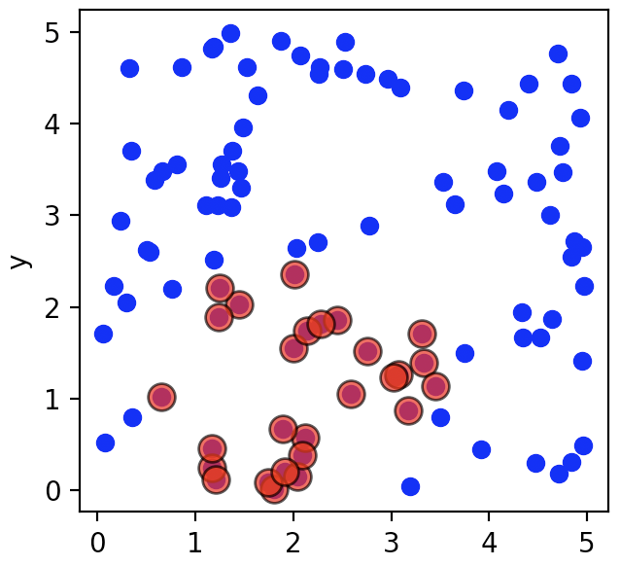
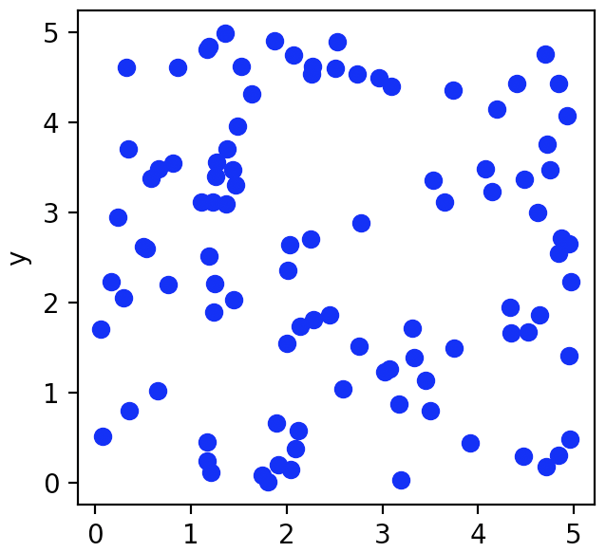
Example
In [149]: import numpy as np
...: import pandas as pd
In [150]: x = np.random.uniform(0, 5, 100)
...: y = np.random.uniform(0, 5, 100)
In [151]: distance = np.sqrt((x - 2)**2 + (y - 1)**2)
In [152]: df = pd.DataFrame({'x': x, 'y': y, 'distance': distance})
...:
In [153]: df
Out[153]:
x y distance
0 2.006298 1.551904 0.551940
1 4.646457 1.865174 2.784288
2 0.498075 2.624852 2.212674
3 4.726508 3.752975 3.874625
4 4.347443 1.667537 2.440511
.. ... ... ...
95 1.358264 4.989811 4.041091
96 2.277221 1.810945 0.857020
97 2.008568 2.353245 1.353272
98 1.242067 1.891226 1.169934
99 2.529332 4.897635 3.933414
[100 rows x 3 columns]

Slide 37
Example
In [149]: import numpy as np
...: import pandas as pd
In [150]: x = np.random.uniform(0, 5, 100)
...: y = np.random.uniform(0, 5, 100)
In [151]: distance = np.sqrt((x - 2)**2 + (y - 1)**2)
In [152]: df = pd.DataFrame({'x': x, 'y': y, 'distance': distance})
...:
In [153]: df
Out[153]:
x y distance
0 2.006298 1.551904 0.551940
1 4.646457 1.865174 2.784288
2 0.498075 2.624852 2.212674
3 4.726508 3.752975 3.874625
4 4.347443 1.667537 2.440511
.. ... ... ...
95 1.358264 4.989811 4.041091
96 2.277221 1.810945 0.857020
97 2.008568 2.353245 1.353272
98 1.242067 1.891226 1.169934
99 2.529332 4.897635 3.933414
[100 rows x 3 columns]
In [154]: # Filter points with distance < 1.5
...: df_filtered = df[df['distance'] < 1.5]

Slide 38
Tomorrow's tutorial
We'll practising manipulating data with pandas then plotting results with matplotlib.
Next Week
Examining tabular data with aggregation and grouping.
Reading: VanderPlas Ch. 4 (See link in Units)

